Slide 1
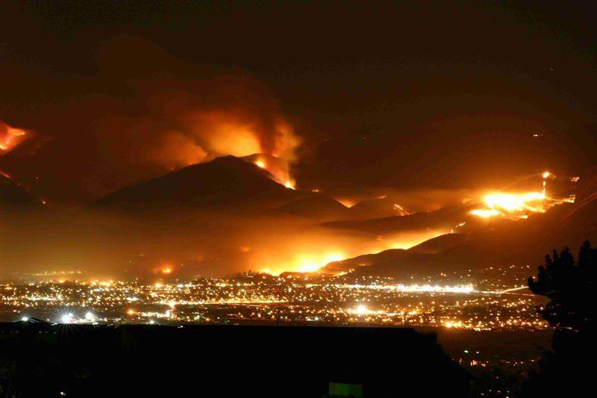
Amateur Radio Operators and the Incident Command System (ICS) Craig Williams W6CAW. Assistant Chief Retired Campo Fire & Rescue.
Working with First Responders

Slide 2
Amateur Radios Role in the 2007 San Diego Wildfires
During the 2007 Harris fire the wired telephone and power infrastructure was burned out in a large area. Some areas did not have utilities restored for eight weeks. Cellular communications in many areas is spotty under normal conditions. With commercial power down, many cell sites quickly used up their backup power.
Amateur radio was called in to provide communications between communities.
Community centers, volunteer fire stations and other points of distribution (POD’s) were setup by community CERT teams and non government organizations (NGO’s).
Amateur radio operators provided communications between these POD’s, and between the POD’s and the San Diego County Emergency Operations Center.

Slide 3
Communications to the County EOC was through RACES/ACS amateur repeater systems, maintained by the county radio shop, co-located on the public service repeater sites which have extensive backup power systems. These “voted” amateur radio systems include the 6M, 2M and 70Cm bands. Additionally, the RACES radio room is located in the EOC and is equipped with computers tied to the EOC’s WebEOC information management system.
Amateur radio operators were called in from throughout the southwest to man the California State Auxiliary Communications Services (ACS) OASIS satellite communications trailers. Located at community POD’s, these trailers provided telephone communications to communities during the recovery phase of the fires.
Due to the large geographic area of the 2007 fires, and the extended period of utility outages, we soon ran out of Amateur Radio Operators. Even with Amateurs from all the major San Diego County clubs, ARES, RACES, and volunteers from outside the county the length of the incidents soon exhausted the pool.

Slide 12
Organization
Ham organizations are encouraged to learn and train with the Incident Command System (ICS) and the National Incident Management System (NIMS).
Ham groups are primarily used as communicators. With a wide range of federally assigned frequencies Hams have the ability to communicate both short range and great distances. Ham operators can communicate without the usual infrastructure employed by IP based modern communications systems.

Slide 13
Ham groups may operate directly under first responders. In these cases they are incorporated into the incident command structure. Assignments and direction is provided by the Incident Command, usually under the Logistics Branch. In San Diego County there is a large and growing RACES/ACS, ARES and CERT Ham component working with their sponsor agencies.
Ham groups may operate under an NGO such as the American Red Cross or the Salvation Army. These NGO’s have defined Ham radio components to support their missions.
Finally, during emergencies, Ham operators may operate within their community to provide communications between the community and first responders. Between scattered points of distribution (POD’s) setup in emergency situations. From neighbor to neighbor, to neighborhood to neighborhood, to local to regional, a well trained and moderately equipped Ham can provide emergency health and welfare communications when all other means of communications is out.

Slide 16
What an Incident Command Post Looks Like Check in

Slide 17
What an Incident Command Post Looks Like Communications

Slide 19
What an Incident Command Post Looks Like Logistics

Slide 20
What an Incident Command Post Looks Like Medical

Slide 21
What an Incident Command Post Looks Like Morning Briefing

Slide 22
What an Incident Command Post Looks Like Feeding

Slide 23
What an Incident Command Post Looks Like Feeding

Slide 24
What an Incident Command Post Looks Like Feeding

Slide 25
What an Incident Command Post Looks Like And Most Important!

